Slide 1
A.I.de
An app to connect researchers with AI test volunteers
Notes:
Kelly: Hello! We are Team Granola and this is our project AIDE, an app to connect researchers with AI test volunteers

Slide 2
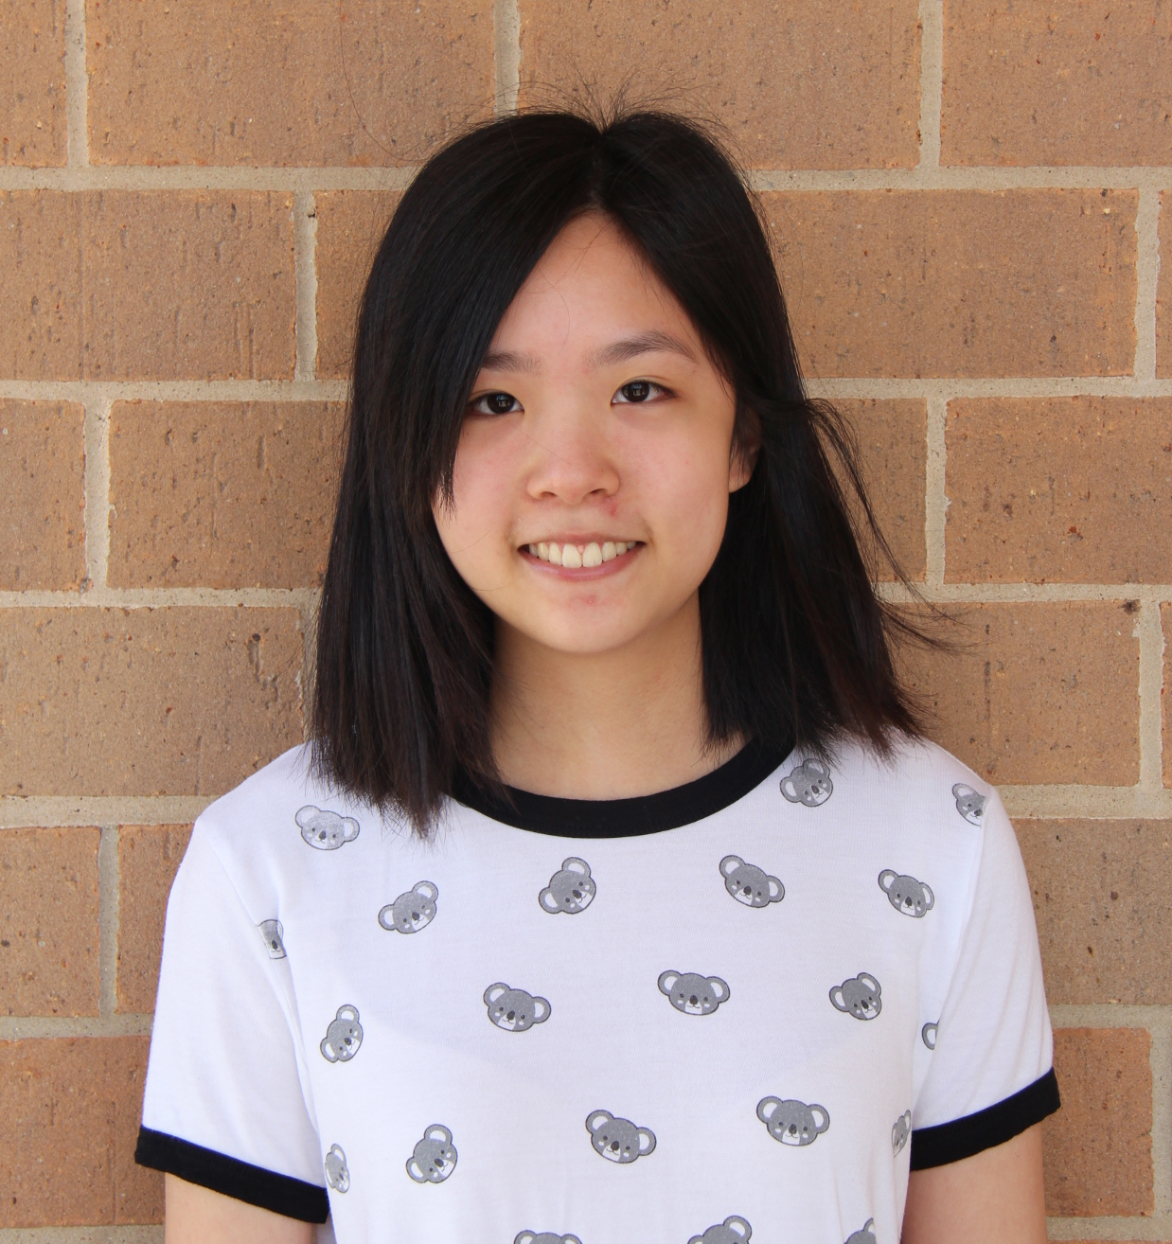
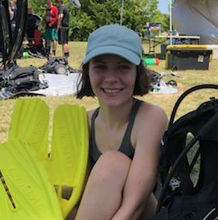

MEET THE TEAM
Kelly Sun
Caitlin Montgomery
Jalyn Derry
Notes:
Jalyn: I am a second year CS major from UT Austin

Slide 3
Aide - a person who acts as an assistant or helper
A.I. - Artificial Intelligence
A.I.de - an app that assists researchers with testing and data collection for AI

Slide 4
01
THE PROBLEM
04
RESEARCHER PATH
02
THE APP
05
DEMO
03
USER PATH
06
FUTURE MODS
Notes:
Kelly - We’re going to run you through our thought process and implementation of this app that we designed over the last 24 hrs at WEHack

Slide 5

AI - Data/Test Collection
As the field of robotics grows, one of the largest hurdles in creating AI and machine learning softwares is access to data and testing materials.
Notes:
Jalyn: First we want to start with the problem. The problem we decided to address is the issue of collecting data for researchers of AI and machine learning. During one of the informative panels at WeHack UTD, we discovered that a big issue with creating AI is teaching them the difference between right and wrong. Whether that be ethically, or just everyday things, they won't know unless a human tells them so.

Slide 6

THE SOLUTION
A.I.de is an app that allows research groups and start-ups input activities for their AI robot to allow users to test their machine learning with fun, easy games. With every game played, the robot gets smarter, while the user earns points to gain prizes
Notes:
We decided the best way to address this issue would be a way for researchers and start up companies to create their testing infrastructure and then leave the data collection to us!

Slide 7

ABOUT A.I.de
FEATURES OF THE PRODUCT
Users and researchers must log in and have their accounts approved.
The app will have default test templates that researchers can use as-is or modify.
Easy download of test data for researchers
Notes:
Kelly: AIDE allows users to submit applications and open accounts to browse available projects that need volunteers to spend time training AI. The companies can then receive the data and use it on their projects.

Slide 8
OUR GOALS
INVOLVEMENT
CENTRALIZED
TIME SAVING
INSPIRING
Allows tech-enthusiasts to contribute to AI development
One central place for AI testing
Testing and data collection is extremely time intensive
Users can learn first-hand about research and AI

Slide 9
USER PATH
STEP 2
STEP 4
STEP 1
STEP 3
STEP 5
Verification Process
Connect with AI
Sign Up
Select Activities
Win Prizes!
Notes:
Step one nd

Slide 10
RESEARCHER PATH
Home Screen
Sign Up
Log In
Vet Company
View Tests
Accepted
Download Data
Delete Outliers
Rejected
Test Dev and implementation

Slide 11
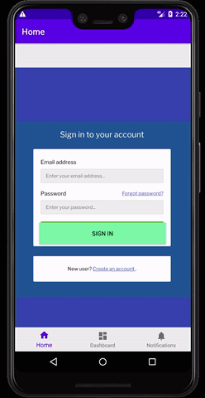
APP DEMO

Slide 12
FUTURE PLANS
CHANNEL
Mobile and desktop
EXPANDED FEATURES
GOALS
We want new users to be able to submit applications through the app rather than through a separate link
Include platform for developing tests
Better system for flagging outliers

Slide 13
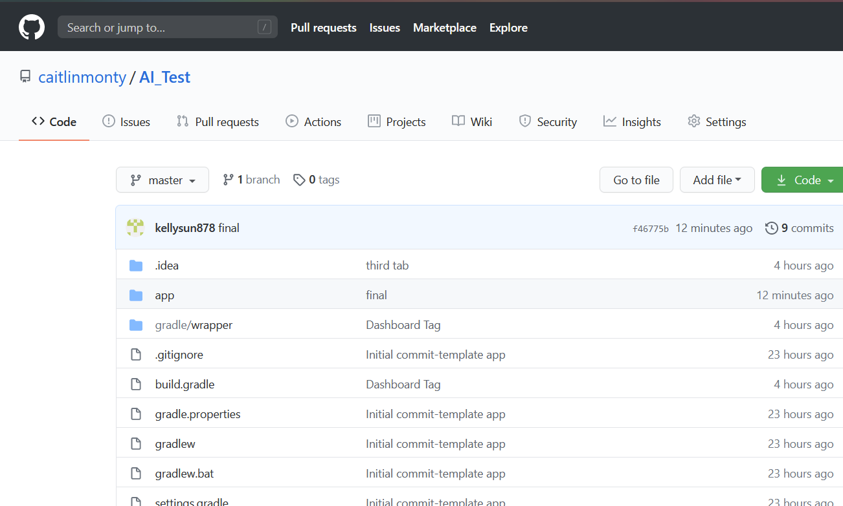
Check Out Our GitHub!
http://bit.ly/
AIDE_Github

